Slide 1

Attendance Display
21107036 : Aman Dhumal
21107053:Om D Jondhale
211070 :Prathamesh Babar
211070 : Rahul Gangurde
Prof. Poonam Pangarkar

Slide 2
Contents
Introduction
Objectives
Features
Built in functions used
Block Diagram
Output Screenshots

Slide 3
1. Introduction
Attendance display system will allow you to see the attendance of students stored in database .

Slide 4
2. Objectives
Write objectives of selected project topic in numbers like
To display attandance of selected student .
To display Id and student name of the the student .

Slide 5
4. Feature
1. students can view their attendance .
2. student name and their id will be displayed after inserting roll no .

Slide 6
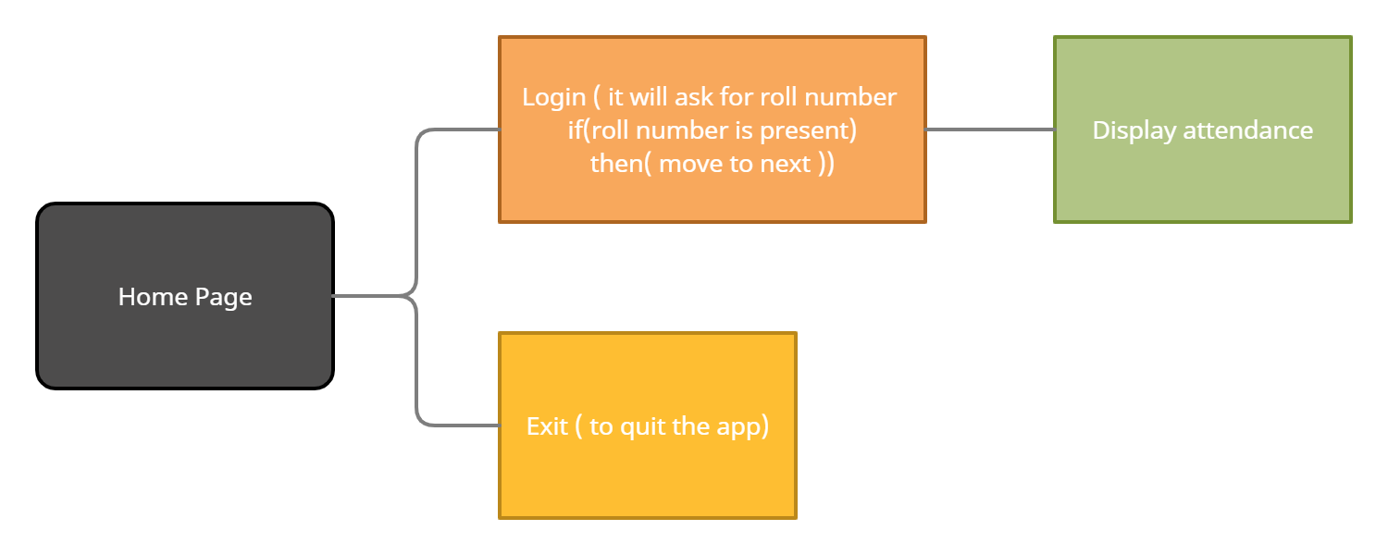
7. Block Diagram/ Flow diagram

Slide 7
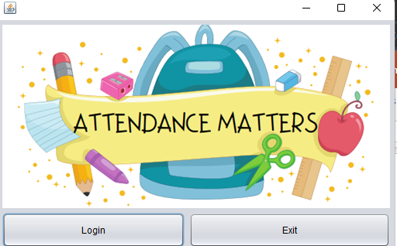
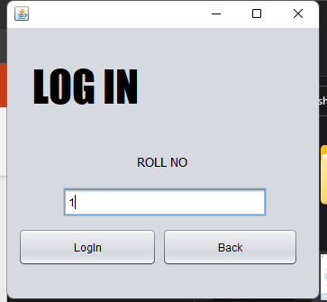
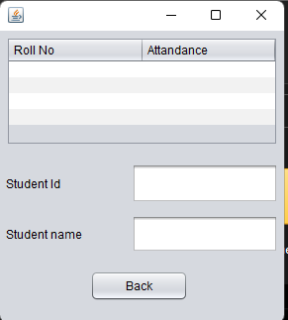
5. Output of Project

Slide 8
Thank You...!!

